Slide 1

Host Listing Analysis for
Airbnb
Team Bruins

Slide 2
Project Overview
Data
8500 Airbnb house listing data in Seattle WA
~300 columns
Goals
Help hosts to understand listing price, review scores, and requirements of being a superhost
Next step
Test accuracy with prediction model
Notes:
David
- Benefits of being a superhost:
- standing out from the crowd - search results improve
- higher occupancy rate
- Earning more money per available day
Current project focus on preliminary tests. Next step will involve prediction model recommendation and model accuracy test.

Slide 3
Data Overview
Airbnb data in Seattle WA
Listing | Host | Review
Listing ID Price Location Property/Room Type Amenities Cancellation policy Cleaning fee ... | Host ID Host URL Host Name Superhost or Not Host photo Location Identity Verified ... | Total Rating Accuracy Cleanliness Checkin Communication Location Value ...
Notes:
David

Slide 4
Statement of Questions
Question 1
As a host, what would be the key factors of getting a high price? What would be the key factors of getting a better review score?
Question 2
As a host, what would be the key factors that would get me higher rating to qualify for a superhost?
Notes:
David

Slide 5
Question 1
As a host, what would be the key factors of getting a higher listing price? What would be the key factors of getting a better review score?
Notes:
David

Slide 6
Model Selection - Why Linear Regression
Given the non-binary nature of our dependent variables (price, review scores) we ruled out Logistic regression and only looked at ANOVA and Linear Regression.
We suspect a linear dose-response relationship between predictor and response for example between host response time and review scores and we expect a higher power to detect this relationship.
The choice also supports assessment with dependent variables of non-factor nature.
Notes:
David

Slide 7
Q1a - Factors for Higher Price
Response: Price
Predictors:
Accommodates
Bedrooms
Bathrooms
Cleaning fee
Notes:
David - Based on our intuition the larger the house is the higher the listing price. We decided to start from this perspective and only consider the properties of the house itself. So we start with bedrooms bathrooms accommodates and cleaning fee. Since we believe cleaning fee is part of the listing price. The larger the house the higher the cleaning fee thus higher price.
The next step will be taking into consider of the values brought from host itself. We believe the super host status and host response time can boost the housing price.

Slide 8
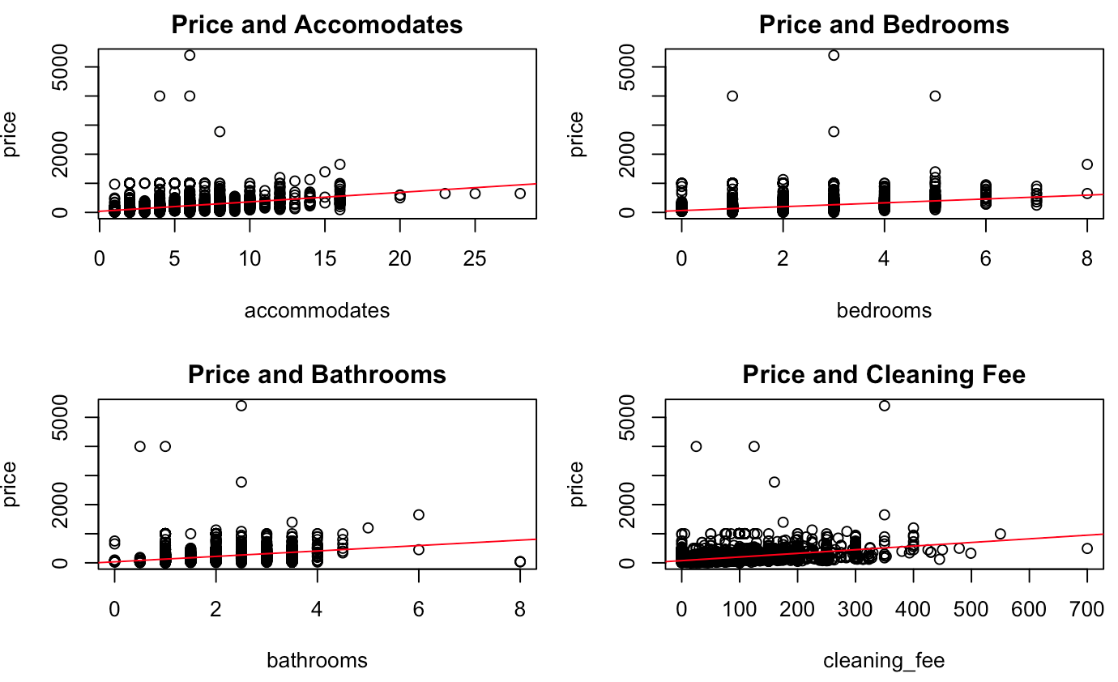
Regression Plots
Notes:
David - linear regression fits here. But we can still see some outliers here. Can compare the outliers with our R-squared values once we get to our test.

Slide 9
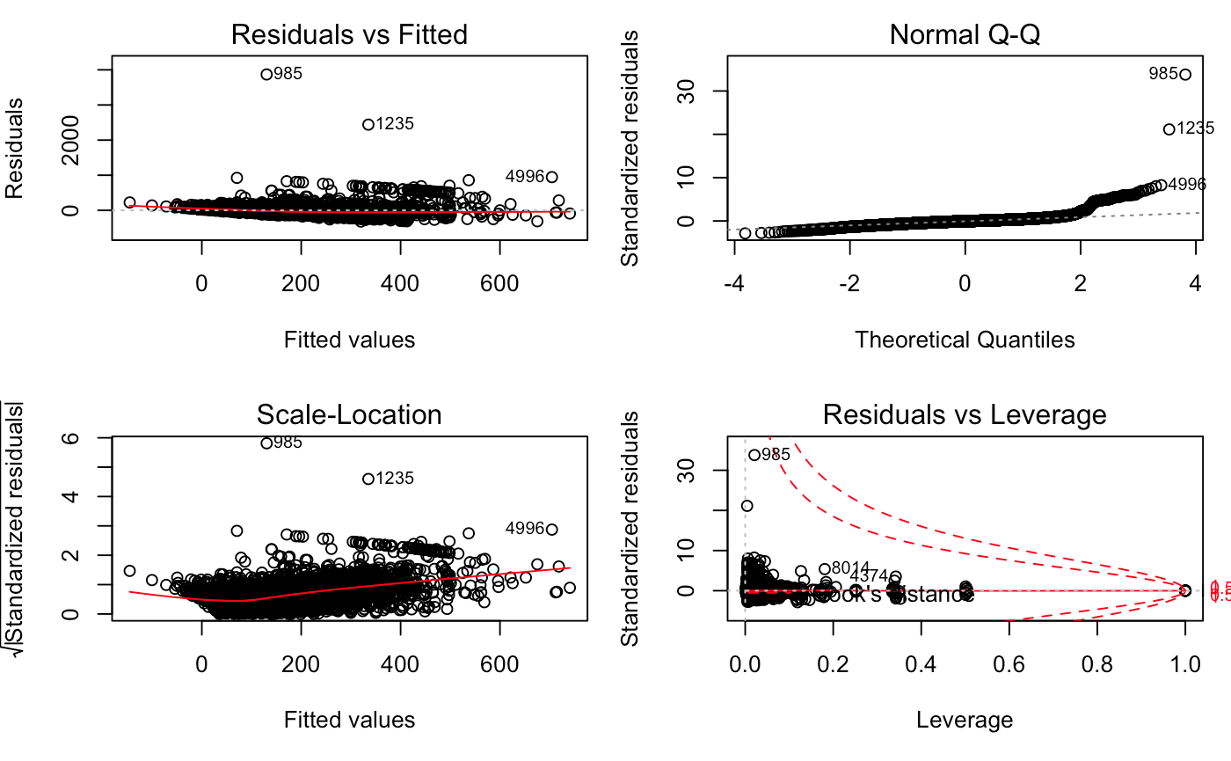
Assumption for Price
Linearity assumption is safe
Satisfactory homoscedasticity
Satisfactory normality
Some extreme outliers
Notes:
David
Independence
Satisfied. Through our knowledge of the Airbnb pricing model (it allows renters to adjust their prices) and how tenants rate their stays we believe the independence of our data set is valid.
Linearity
Satisfied. From Figure 1 we can see the red line being horizontal. This is good evidence on linearity.
Constant variance
Satisfied. From Figure 1 we can see most data points are around zero-line. Although there exists a weakly positive relationship between mean and variance from Figure3.
Normality
Satisfied. Figure 2 suggested a reasonable approximation to a normal distribution with a slightly heavy tail. We accept this heavy tail as outliers exist in our model. Given the large size of our sample (8459) we do not have to take normality strictly.

Slide 10
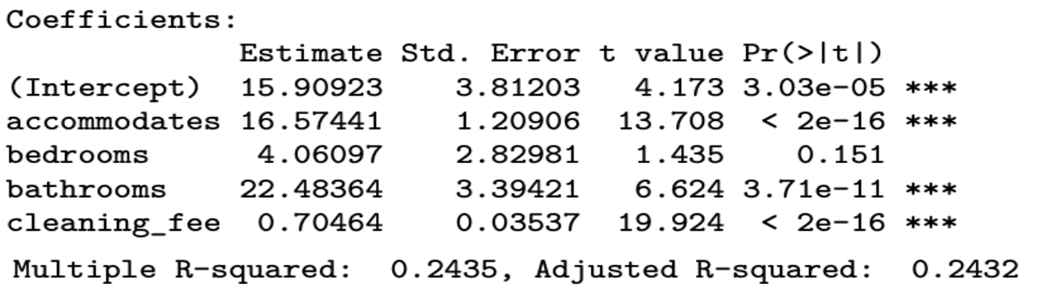
Results/Analysis - Q1a for Price
The number of bedrooms for a listing failed to attain significance
Adjusted R-squared is low, much variability unaccounted for Possible reasons for this
Existence of a few extreme outliers
Lack of relevant predictors
Some relationships (e.g. interactions) unaccounted for
Takeaways under assumptions of this model
More bathrooms (Coef = 22.48) associate with higher prices than bedrooms (4.06)
The capacity to accommodate more guests associates with higher prices (Coef = 16.57)

Slide 11
Q1b - Factors for Review Scores
Response Variables: Review Scores [‘review_scores_value’, 0-10]
Predictor Variable Selection Steps:
Intuitive Variable Selection from existing/engineered variables
Assumptions Check
Factor Selection through Stepwise [Forward/Backward elimination] Regression
Final Results

Slide 12
Intuitive Variable Selection
from Existing/Engineered Variables
Price
Accommodates
Bedrooms
Guests included
Minimum nights
Host listings count
Host response rate
Host is superhost
Total Amenities

Slide 13
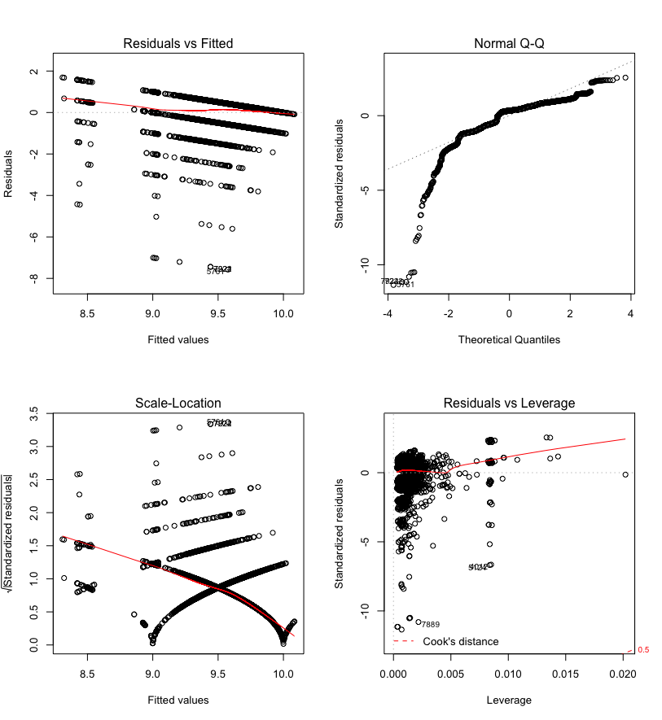
Assumption Check - Full Model
Independence between the variables is assumed
Heavy-tailed distribution is a deviation from Normality, but this is ignored due to the large size of the dataset
Linearity and Variance assumptions hard to read

Slide 14
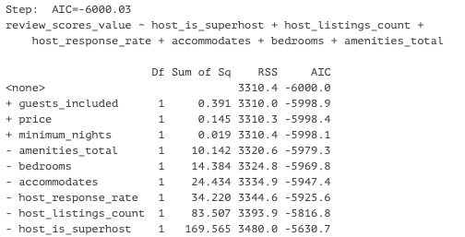
Factor Selection - Stepwise [Forward/Backward] Regression
Stepwise regression [works through AIC minimization] narrows the list down to 6 variables.
Possible overfitting, needs to be checked for accuracy in further tests
AIC = - 2*log L + k * edf;
L = likelihood
edf = equivalent degrees of freedom
k = number of parameters

Slide 15
Factor Selection - Stepwise [Forward/Backward] Regression
 | Estimate | Std. Error | t-value | Pr(>|t|)
(Intercept) | 9.53E+00 | 2.51E-02 | 379.3 | < 2.00E-16 ***
host_is_superhost | 3.45E-01 | 1.77E-02 | 19.504 | < 2.00E-16 ***
host_listings_count | -6.85E-04 | 5.01E-05 | -13.688 | < 2.00E-16 ***
host_response_rate | -1.85E-03 | 2.11E-04 | -8.762 | < 2.00E-16 ***
accommodates | -4.31E-02 | 5.82E-03 | -7.404 | 1.47E-13 ***
bedrooms | 7.40E-02 | 1.30E-02 | 5.681 | 1.39e-08 ***
amenities_total | 3.87E-03 | 8.10E-04 | 4.77 | 1.88e-06 ***
Residual standard error: 0.6676 on 7427 degrees of freedom
Multiple R-squared: 0.1142, Adjusted R-squared: 0.1134
F-statistic: 159.5 on 6 and 7427 DF, p-value: < 2.2e-16

Slide 16
Assumption Check - Fitted Model
The observations are the same as the full model

Slide 17
Q1b Results Analysis for Review Scores
Average number of reviews per listing: 45
All predictors attained significance
Adjusted R-squared is low, much variability unaccounted for Possible reasons for this
Lack of relevant predictors
Confounding relationships
Some relationships (e.g. interactions) unaccounted for
Weak adherence to assumptions, groupings of outliers
Takeaways under assumptions of this model
Seattle Airbnb hosts are highly competent, judging by review scores (Intercept = 9.5)
Being a Superhost (.345) and having more bedrooms (.074) associate most with review scores
Host response rate (-.002) and number of listings (-.0007) associate least with review scores
There are some complex challenges to modeling review scores, including selection bias

Slide 18
Future Steps for Prediction
Isolate a main effect with more rigorous testing
Account for confounding relationships when adding secondary effects
Test for interactions around predictors
Train and test the model

Slide 19
Question 2
As a host, what are the important factors that would get me higher ratings to qualify for being a superhost?
Notes:
Monique
For the next question, we will be looking at the most important factor that would help the host become a superhost.

Slide 20
Criterion to Be a Superhost
“Superhosts are experienced highly rated hosts who are committed to providing great stays for guests.” -- Airbnb
Hosted at least 10 trips
Maintained a 90% response rate or higher
Received a 5-star review at least 80% of the time being reviewed as long as at least half of the guests who stayed at the property left a review
Completed each of the confirmed reservations without canceling
Notes:
Monique
From airbnb website, there are four main criterion to become a superhost,
Hosted at least 10 trips Maintained 90% or higher response rate
Received 5-star review at least 80% of the time
Completed all confirmed reservations without canceling
No. 1,2,4 can be easily quantified,
So we will focus on No.3 to evaluate, of all guest review categories, which one would contributes to an overall higher review score
helping the hosts prepare their properties and listings.
(Click for animation)

Slide 21
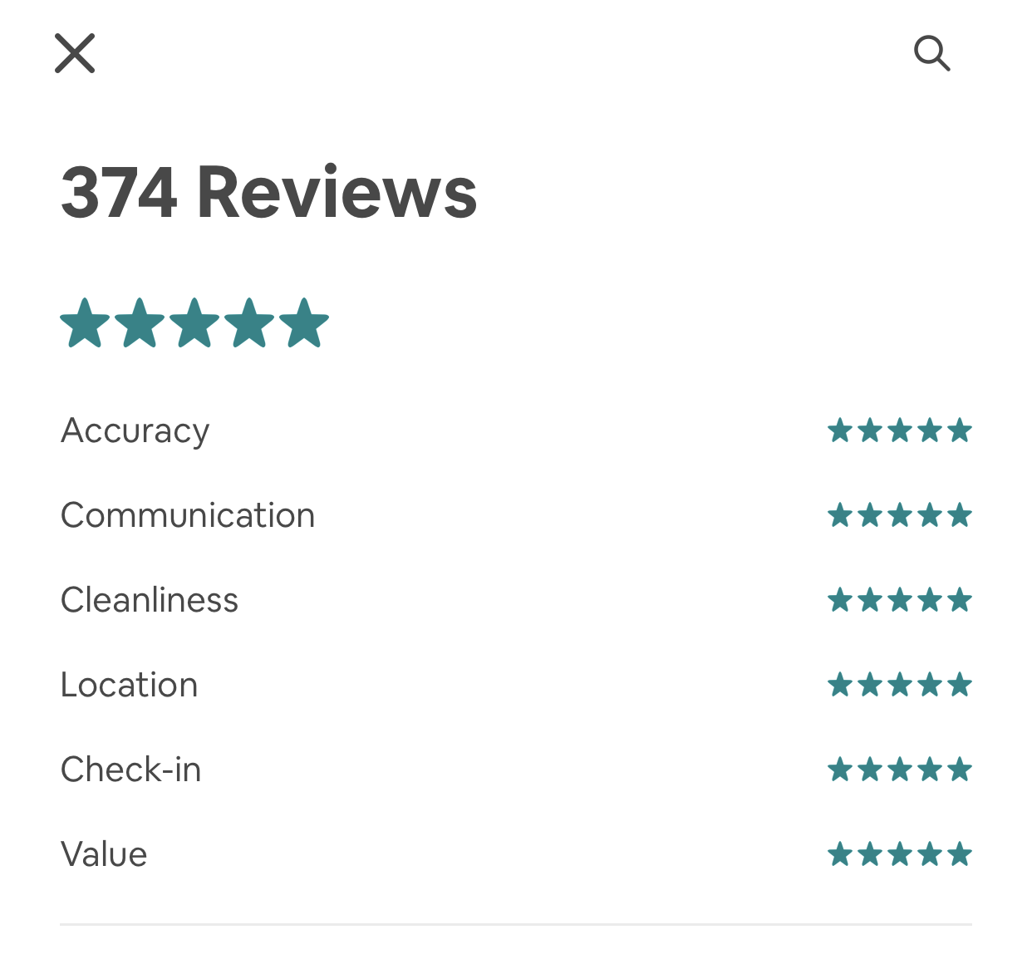
Six Star Rating Categories*
Accuracy. How accurately did your listing page represent your space?
Communication. How well did you communicate with your guest before and during their stay?
Cleanliness. Did your guests feel that your space was clean and tidy?
Location. How did guests feel about your neighborhood?
Check-in. How smoothly did their check-in go?
Value. Did your guest feel your listing provided good value for the price?
* https://www.airbnb.com/help/article/1257/how-do-star-ratings-work
Notes:
Monique
Airbnb has six star rating categories, accuracy, communication, cleanliness, location, check-in and value.
Each rating score ranges from 0 to 10,
Take a guess: Which category do you think is the most important one to help hosts becoming a superhost?

Slide 22
Statistical Model: Logistic Regression
Hypothesis
The association between being a superhost and each of the six review categories.
Response host_is_superhost 0/1
Predictors Review scores in 6 categories
Model
glm(superhost~accuracy+communication+cleanliness+location+checkin+value, data=hostData,family=binomial)
Notes:
Monique
After doing background researches, we built our hypothesis to find if there is association between being a superhost and each of the six review categories.
With binary dependent variable superhost, and more than one review category, we choose Logistic Regression as our primary model and evaluate the assumptions.

Slide 23
Assumptions - Logistic Regression
Binary dependent variables
Superhost response variable being 0/1.
Independent observation variables
The study is an observation study, we could assume that each booking is independent from each other.
No strong intercorrelations among predictor variables
Pearson correlation table and correlation matrix plot
Notes:
Monique
For logistic regression, we the following assumptions:
The Superhost response variables are 0/1, so the binary assumption is satisfied.
(Click for animation)
As an observation study, we could assume that each booking is independent from each other, independence is also checked.
For the intercorrelations assumption, we used Pearson correlation table and correlation matrix plot.

Slide 24
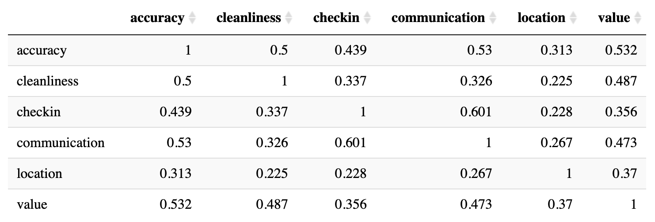
Assumptions - Logistic Regression
No strong intercorrelations among predictor variables.
Pearson Correlation Table
Notes:
Monique
In the table,the largest correlation is 0.601 between communication and checkin.

Slide 25
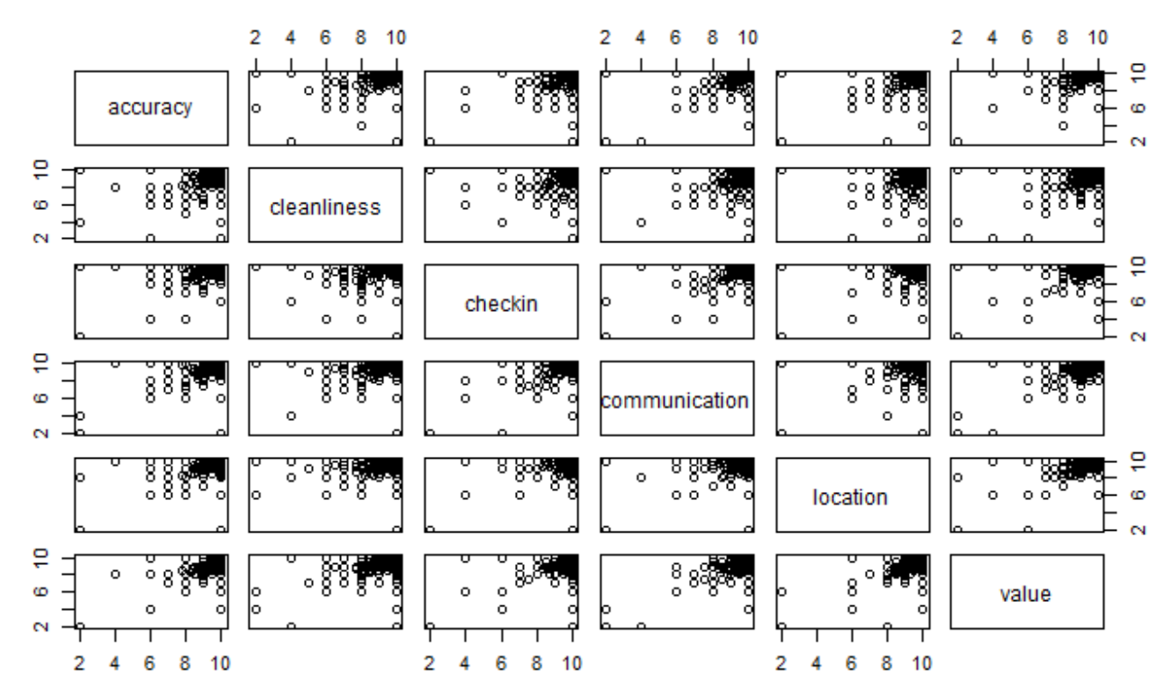
Assumptions - Logistic Regression
No strong intercorrelations among predictor variables.
Correlation Matrix Plot
Notes:
Monique
The correlation matrix plot shows no strong intercorrelations,
So we can assume this assumption is also checked.
(Click for animation)

Slide 26
Assumptions - Logistic Regression
Linearity of independent variables and log odds
There is a linear relationship between the logit of the outcome and each predictor variables.
Large sample size
There are 5302 observations (distinct hosts in Seattle) after averaging the review scores for hosts with more than one listing.
Notes:
Monique
(Click for animation)
There is a linear relationship between the log odd of the outcome and each predictor variables. (residuals vs. fitted value plus smoother)
The sample size is more than 5000 after taking care of hosts with multiple listings, so the linearity and large sample size assumptions are met.

Slide 27
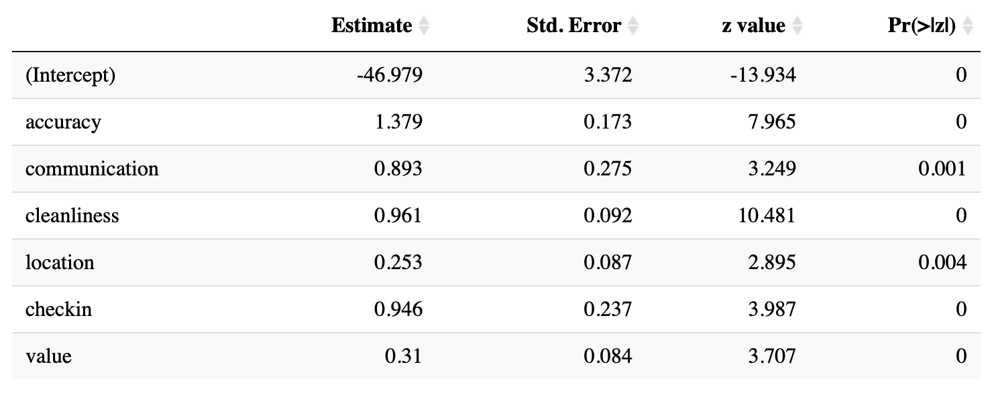
Coefficient Estimate Table
Notes:
Cathy
So from the logistic regression model, which we have satisfied all the assumptions, we got this coefficient estimate table. We can see all the p-values here for each rating category is pretty small. So we can safely reject the null hypothesis and we have the evidence that these 6 rating categories have effect on whether a host can become a superhost.

Slide 28
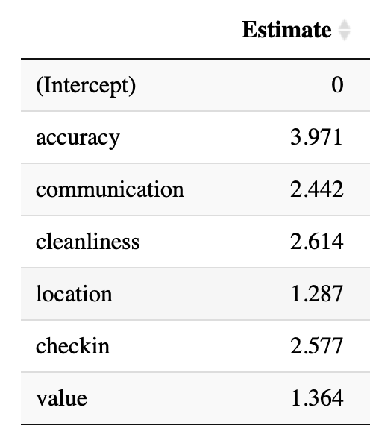
Interpretation of the Association
Exponentiated Coefficient Estimate
Accuracy: 3.971 - Holding other predictors fixed there is a 297.1% increase in odds of becoming a superhost for one-unit increase in accuracy rating.
Communication: 144.2% increase in odds
Cleanliness: 161.4% increase in odds
Location: 28.7% increase in odds
Check-in: 157.7% increase in odds
Value: 36.4 % increase in odds
Notes:
Cathy
Now we can use the exponentiated coefficient estimate to interpret the association between superhost and different rating categories.
Let’s take the accuracy as an example. …
Similarly, we can interpret the association for other rating categories.

Slide 29
Rank Rating Categories
Accuracy. How accurately did listing page represent your space?
Cleanliness. Clean and tidy?
Check-in. How smoothly did check-in go?
Communication. How well did you communicate with your guest?
Value. Good value for the price?
Location. About your neighborhood?
Notes:
Cathy
Ranked the categories by the exponentiated coefficients, which gives us the rank of importance of the 6 factors. Thinking about the real life, this ranking is pretty reasonable.
For first 4 factors: Accuracy, cleanliness, check-in and communication
They have more than 100% increase in possibility to become a superhost for each unit increase in rating when we have other factors fixed. These 4 factors are more related to how the guests will feel after they live in the space and how smoothly they can interact with the hosts. They are the most important factors for a host.
For the left 2 factors: Value and location
They have lower association because usually guests should have already evaluated the location or the value of this listing before they make reservation.So it is safer to say that a reasonable price and a great location can attract more guests to choose your listing and help raising the overall satisfaction.

Slide 30
Conclusion
Associated with higher listing price:
Higher bathroom counts
Ability to accommodate more guests
Associated with higher review scores
Superhost status
Utilize listings with more bedrooms
Priorities for becoming a superhost
Maintain accurate listing information
Ensure cleanliness of the space
An easy check-in procedure
Positive interactions with customers
Reasonable price and great location also help in raising the overall review scores.
Hosts want: Profit and ratings
Guests want: Bedrooms, bathrooms, clean space and honesty
Airbnb wants: Superhosts

Slide 31

Notes:
Question Time!

Slide 32
Thank you!

